Slide 1
Very Serious Cryptograph
Kalmar CTF

Slide 2
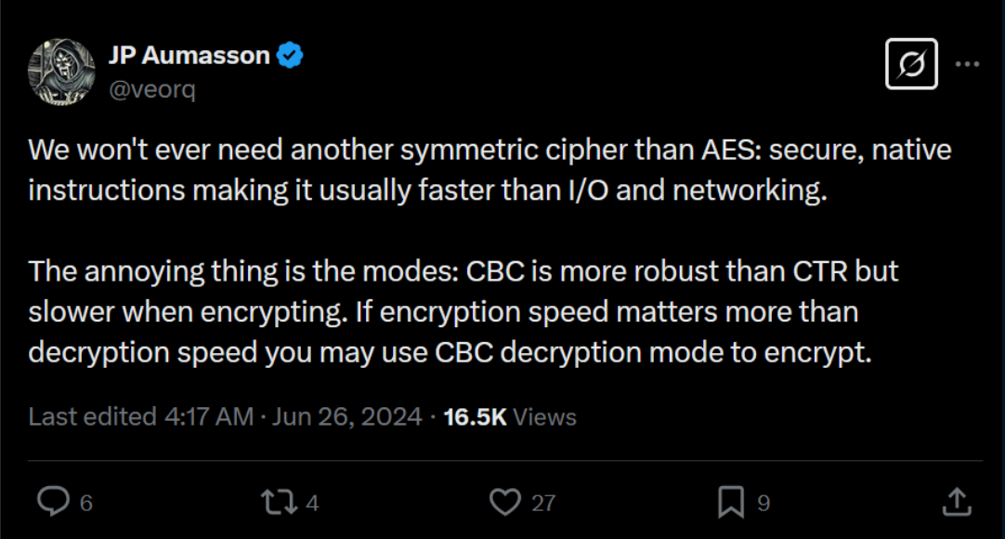
Challenge outline

Slide 3
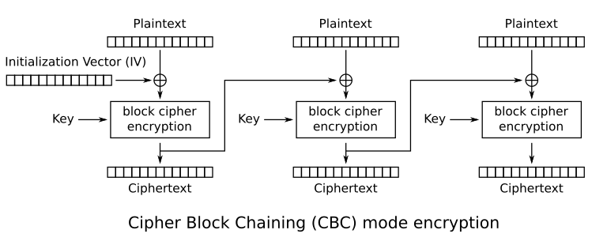

Slide 4
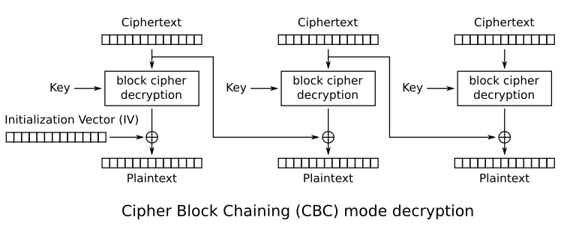

Slide 5
Plaintext block
Same
Plaintext block
Block Cipher
Block Cipher
Ciphertext block
Same
Ciphertext block

Slide 6
Controlled Plaintext block
Guessing
Plaintext block
Block Cipher
Block Cipher
Ciphertext block
Ciphertext block

Slide 7
Controlled Plaintext block
0xAAAAAA
Guessing
Plaintext block
0xAAAAAB
Block Cipher
Block Cipher
Ciphertext block
Same
Ciphertext block

Slide 8
Dear bobby, as a
token of the de
pth of my feelin
gs, I gift to yo
u that which is
most precious to
me. A b'kalmar{
1234567890abcdef
}'
Dear bobbert, as
a token of the
depth of my feel
ings, I gift to
you that which i
s most precious
to me. A b'kalma
r{1234567890abcd
ef}'

Slide 9
Dear AAAAAAAAAAA
ost precious to
me. A b'kalmar{x
AAAAAAAAA, as a
token of the dep
th of my feeling
s, I gift to you
that which is m
ost precious to
me. A b'kalmar{1
234567890abcdef}
'

Slide 10
Dear AAAAAAAAAAA
ost precious to
me. A b'kalmar{x
AAAAAAAAA, as a
token of the dep
th of my feeling
s, I gift to you
that which is m
ost precious to
me. A b'kalmar{1
234567890abcdef}
'
Controlled Plaintext block
Guessing
Plaintext block
Block Cipher
Block Cipher
Ciphertext block
Same
Ciphertext block

Slide 11
Dear AAAAAAAAAAA
ost precious to
me. A b'kalmar{x
AAAAAAAAA, as a
token of the dep
th of my feeling
s, I gift to you
that which is m
ost precious to
me. A b'kalmar{1
234567890abcdef}
'
Controlled Plaintext block
Guessing
Plaintext block
Block Cipher
Block Cipher
Ciphertext block
Same
Ciphertext block

Slide 12
Mitigation
Don’t use encryption modes to encrypt data (if speed in AES encryption is key, use CTR mode
Don’t use a fixed Nonce

